Slide 1

DETECTION OF EXERCISE AND COOKING SCENE FOR ASSISTANCE OF VISUALLY IMPAIRED PEOPLE
2nd International Conference on Pervasive Computing and Social Networking (ICPCSN 2022)
Organized by - Narasu's Sarathy Institute of Technology, Salem, India
3rd March 2022
Paper ID – 40
Presented by -
Prof. Shripad Bhatlawande, Prof. Swati Shilaskar, Prof. Jyoti Madake, Anant Abhyankar, Mahesh Ahire, Ankush Chadgal
Vishwakarma Institute of Technology, Pune, India

Slide 2
INDEX
INTRODUCTION
LITERATURE REVIEW
METHODOLOGY
RESULT
CONCLUSION
REFERENCES

Slide 3
1. INTRODUCTION

Slide 4
Introduction to the Problem Statement
Globally, 2.2 billion people have Vision impairment
Need assessment and requirement analysis
Difficulty in gaining knowledge about the surroundings.
Recognition of exercise and cooking scene based on computer vision technique.

Slide 5
2. LITERATURE REVIEW

Slide 6
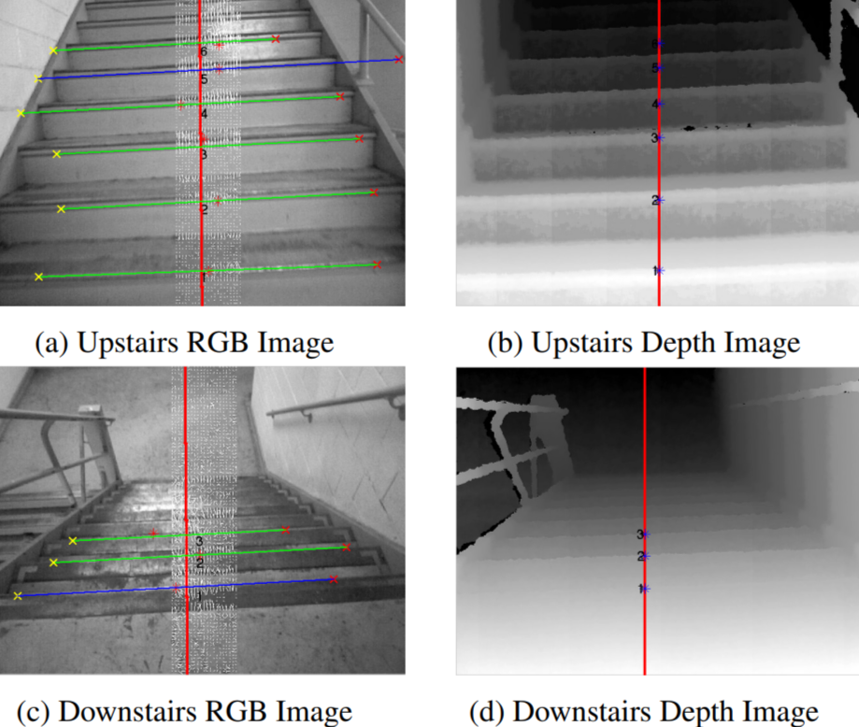
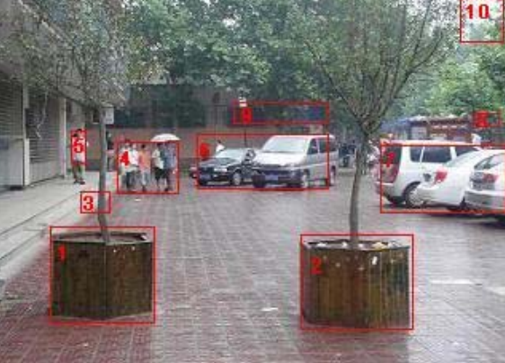
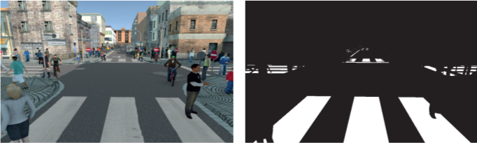
Literature Review
Staircase Detection
Real Time Detection
SVM based multi-classifier is trained and tested for the staircase recognition
Recognition accuracies of 88.89% for upstairs, 95.56% for downstairs
Obstacle Detection
Indoor and outdoor obstacle can be detected
obstacle information is transformed into voice
Zebra-Crossing Detection
Convolutional neural networks (CNN) algorithm is used.
Safe navigation for visually impaired
References : [1], [2], [3].

Slide 7
Literature Review
Third eye for Visually Challenged:
Ultrasonic Sensors and IR sensors are used for obstacle detection and water detection.
All the sensors are interfaced with Arduino UNO for processing purposes.
The audio instructions will be invoked when any obstacles or water is detected
Smart Glove to Aid the Visually Impaired:
A prototype of smart glove is designed which is effective in guiding the blind to the object that is desired in an indoor environment
For object detection Deep Neural Networks (DNN) algorithm is used.
References : [4], [5].

Slide 8
3. METHEDOLOGY
Feature Vector
Compilation
01
Dataset and Pre-processing
03
02
Classification and Detection of a Scene

Slide 9
Novelty
Wearable System Approach
Simplified Audio Feedback
Real-Time Detection of Exercise Scene and Cooking Scene
Good Accuracy – Using Random Forest 80%

Slide 10
Block Diagram of the System
Camera
Processor-based system
Detection of exercise scene
Detection of cooking scene
Earphone
Image translation to an audio feedback

Slide 11
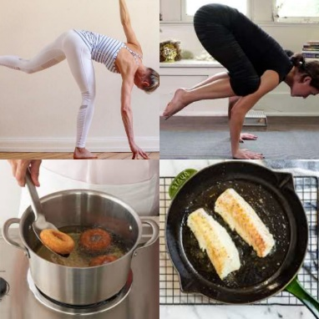
3.1 Dataset and Pre-processing
Dataset :
Total 8220 Images
Two scene: i) Exercise and ii) Cooking
Pre-processing :
Resizing the image in 200x200 pixels
Gray scaling the image
Priority Scenes | No. of Positive Images
Exercise | 3550
Cooking | 1120
No. of Negative Images | 3550
No. of Total Images | 8220
Sample Images from the Dataset [6]-[7]

Slide 12
3.2 Feature Vector Compilation
Scale Invariant Feature Transform (SIFT) :
It is used to extract the local features of an image.
SIFT has dimensions ‘M x 128’.
The feature vector extracted by SIFT was 20,19,256 x 128.
Why SIFT?
Invariant to Scale, Rotation
Efficient
Robust to occlusion and clutter
K-Means Clustering :
Unsupervised Machine Learning Technique
Using Elbow method K=5.
WCSS (Within Cluster Sum of Squares).
Feature vector size 20,19,256 x 128 reduced to 8220 x 5.

Slide 13
Principal Component Analysis (PCA) :
SIFT feature vector shape =2019256 rows × 128 columns
Feature vector shape =
8220 rows × 5 columns
K-Means
PCA
Input features
to the classifiers
Feature vector shape =
8220 rows × 4 columns

Slide 14
3.3 Classification and Detection of a Scene
Optimised Feature Vector
Classifier
Desired scene not detected
Yes
No
Exercise scene detected
Cooking scene detected
Conversion of the detected scene to audio feedback
Earphone

Slide 15
Classification
Decision Tree
1
Support Vector Machine (SVM)
2
3
K-Nearest Neighbour(K-NN)
4
Random Forest
Logistic Regression
5

Slide 16
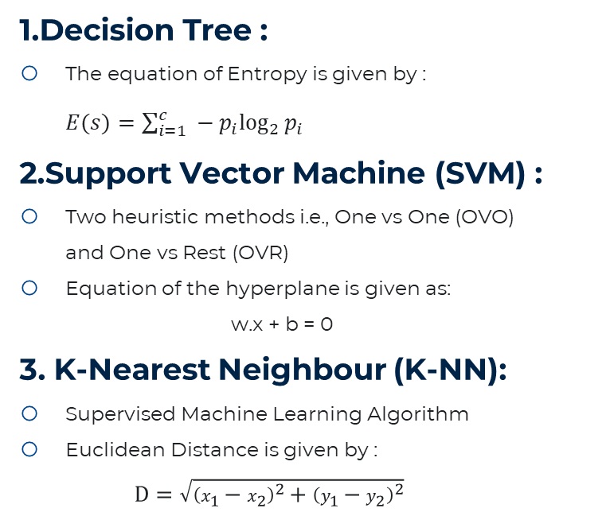
1.Decision Tree :
The equation of Entropy is given by : $E(s)=\sum_{i=1}^{c}{ }−p_{i}\log_{2}⁡p_{i}$
2.Support Vector Machine (SVM) :
Two heuristic methods i.e., One vs One (OVO) and One vs Rest (OVR)
Equation of the hyperplane is given as:
w.x + b = 0
3. K-Nearest Neighbour (K-NN):
Supervised Machine Learning Algorithm
Euclidean Distance is given by :
$$D=\sqrt{{\left(x_{1}−x_{2}\right)}^{2}+{\left(y_{1}−y_{2}\right)}^{2}}$$
4. Random Forest:
Supervised Machine Learning Algorithm Based
Number of trees used were 1000.
5. Logistic Regression:
Supervised Machine Learning Algorithm
It gives the probabilistic values which lie between 0 and 1.

Slide 17
Algorithm: Classification and Detection of a Scene
Input: Optimized feature vector (8220 rows × 4 columns)
Output: Classified Exercise and Cooking Scene
Initialize: min_accuracy = 75.91%
Procedure:
1: Fit the model with training data for the Random Forest classifier
2: Predict the test data using this pre-trained model
3: if (predicted class label ==0 && accuracy >= min_accuracy)
4: return Exercise Scene Detected
5: else if (predicted class label ==1 && accuracy >= min_accuracy)
6: return Cooking Scene Detected
7: else if (predicted class label ==2 && accuracy >= min_accuracy)
8: return Neither Exercise nor Cooking Scene
9: else
10: return Not able to classify the scene

Slide 18
4. RESULT

Slide 19
Data Visualisation
Priority Classifiers | Training accuracy | Testing accuracy
Decision Tree | 75.71% | 75.91%
SVM – OVR Linear | 78.68% | 79.50%
SVM – OVR Polynomial | 76.58% | 77.98%
SVM – OVR RBF | 79.80% | 80.17%
SVM – OVO Linear | 78.68% | 79.50%
SVM – OVO Polynomial | 76.58% | 77.98%
SVM – OVO RBF | 79.80% | 80.17%
K-NN | 84.48% | 79.31%
Random Forest | 92.92% | 80.83%
Logistic Regression | 78.90% | 79.68%

Slide 20
Performance Metrics
Priority Classifiers | Precision score | Recall score | F1 score
Decision Tree | 50.71% | 58.29% | 54.22%
SVM – OVR Linear | 74.64% | 67.13% | 68.22%
SVM – OVR Polynomial | 76.09% | 63.85% | 64.25%
SVM – OVR RBF | 75.25% | 68.18% | 69.40%
SVM – OVO Linear | 74.50% | 67.13% | 68.22%
SVM – OVO Polynomial | 76.09% | 63.85% | 64.25%
SVM – OVO RBF | 75.25% | 68.18% | 69.14%
K-NN | 72.43% | 70.09% | 70.88%
Random Forest | 75.36% | 71.58% | 72.80%
Logistic Regression | 73.86% | 68.34% | 69.50%

Slide 21
Advantages and Limitation
Advantages :
Detection of Exercise and Cooking Scene
Simplified Audio Feedback
Wearable System
Good Accuracy – 80%
Cost Effective System
Limitation :
Non-Uniform Illumination may be a Concern

Slide 22
5. CONCLUSION

Slide 23
Conclusion
Accurate Classification and Detection of Exercise and Cooking Scene (Accuracy = 80%)
A Novel Method (Blend of K-Means Classifier + PCA) for Dimensionality Reduction
Multi-Class Classification with Array of Classifiers
Helpful for visually disabled people to sense Exercise and Cooking Scene
Possible inclusion of activities such as swimming, playing cricket, and many other things if trained accordingly

Slide 24
6. REFERENCES

Slide 25
References
Munoz, Rai; Xuejian Rong, ; Tian, Yingli (2016). [IEEE 2016 IEEE International Conference on Multimedia & Expo Workshops (ICMEW) - Seattle, WA, USA (2016.7.11-2016.7.15)] 2016 IEEE International Conference on Multimedia & Expo Workshops (ICMEW) - Depth-aware indoor staircase detection and recognition for the visually impaired.
R. Munoz, Xuejian Rong and Y. Tian, "Depth-aware indoor staircase detection and recognition for the visually impaired," 2016 IEEE International Conference on Multimedia & Expo Workshops (ICMEW), 2016, pp. 1-6,
Y. Akbari, H. Hassen, N. Subramanian, J. Kunhoth, S. Al-Maadeed and W. Alhajyaseen, "A vision-based zebra crossing detection method for people with visual impairments," 2020 IEEE International Conference on Informatics, IoT, and Enabling Technologies (ICIoT), 2020, pp. 118-123
Arvitha, M. V. S., Biradar, A. G., & Chandana, M. (2021). Third Eye for Visually Challenged Using Echolocation Technology. 2021 International Conference on Emerging Smart Computing and Informatics (ESCI).

Slide 26
References
Jain, Sambhav; Varsha, Sushanth D; Bhat, Vijetha N; Alamelu, J V (2019). [IEEE 2019 International Conference on Communication and Signal Processing (ICCSP) - Chennai, India (2019.4.4-2019.4.6)] 2019 International Conference on Communication and Signal Processing (ICCSP) - Design and Implementation of the Smart Glove to Aid the Visually Impaired.
Shruti Saxena, Yoga Pose Image Classification Dataset, Apr. 3, 2021. Accessed on: Nov. 25, 2021. [Online]. Available: https://www.kaggle.com/shrutisaxena/yoga-pose-image-classification-dataset
“Cooking using pan,” Oct. 20,2021. Accessed on: Nov. 25, 2021.[Online].Available: https://www.google.co.in/search?q=cooking+using+pan&hl=en&tbm=isch&source
A. A. Rafique, A. Jalal and A. Ahmed, "Scene Understanding and Recognition: Statistical Segmented Model using Geometrical Features and Gaussian Naïve Bayes," 2019 International Conference on Applied and Engineering Mathematics (ICAEM), 2019, pp. 225-230

Slide 27
We would like you express our gratitude and thank you for giving us an amazing opportunity to present our paper in ICPCSN 2022 Conference.
THANK YOU!

